Slide 1
CAB RIDE AND PRICE
SUBMIT BY-
VIKAS DATA
AL WASI KHAN
SANDIPTA SUBIR KHARE

Slide 2
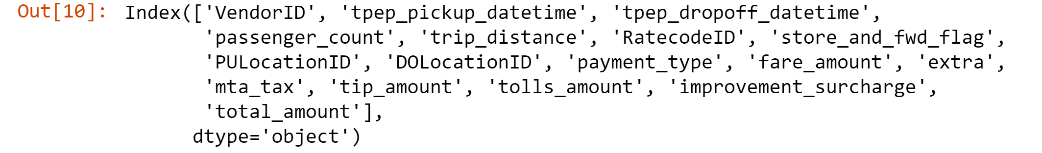
COLUMNS IN DATASET

Slide 3
In today’s world there is highest usage of cabs such as UBER, OLA and LYFT. These cabs services are more cheaper than passenger’s own private vehicle. According to many passengers, buying new car and then maintaining it which includes the car’s insurance policy is expensive as compare to cabs.
The objective of using classification is to predict the usage of cabs. With the help of classification we had minimize the prediction error and maximize the accuracy.
Regression analysis is a statistical method to model the relationship between a dependent (target) and independent (predictor) variables with one or more independent variables. More specifically, Regression analysis helps us to understand how the value of the dependent variable is changing corresponding to an independent variable when other independent variables are held fixed.
There are a total of 17 columns and 1048576 rows labels included.

Slide 4
LINEAR REGRESSION: Linear regression is a statistical regression method which is used for predictive analysis. Linear regression shows the linear relationship between the independent variable (X-axis) and the dependent variable (Y-axis), hence called linear regression. If there is only one input variable (x), then such linear regression is called simple linear regression. And if there is more than one input variable, then such linear regression is called multiple linear regression.
SVM(SUPPORT VECTOR MACHINE): Support vector machine (SVM) analysis is a popular machine learning tool for classification and regression. SVM regression is considered a nonparametric technique because it relies on kernel functions.
DECISION TREE: Decision trees are constructed via an algorithmic approach that identifies ways to split a data set based on different conditions. It is one of the most widely used and practical methods for supervised learning. Decision Trees are a non-parametric supervised learning method used for both classification and regression tasks. Decision trees where the target variable can take continuous values (typically real numbers) are called regression trees. Classification And Regression Tree (CART) is general term for this.
RANDOM FOREST: A Random Forest is an ensemble technique capable of performing both regression and classification tasks with the use of multiple decision trees and a technique called Bootstrap Aggregation, commonly known as bagging. The basic idea behind this is to combine multiple decision trees in determining the final output rather than relying on individual decision trees.

Slide 5
X AND Y DECLERATION

Slide 6
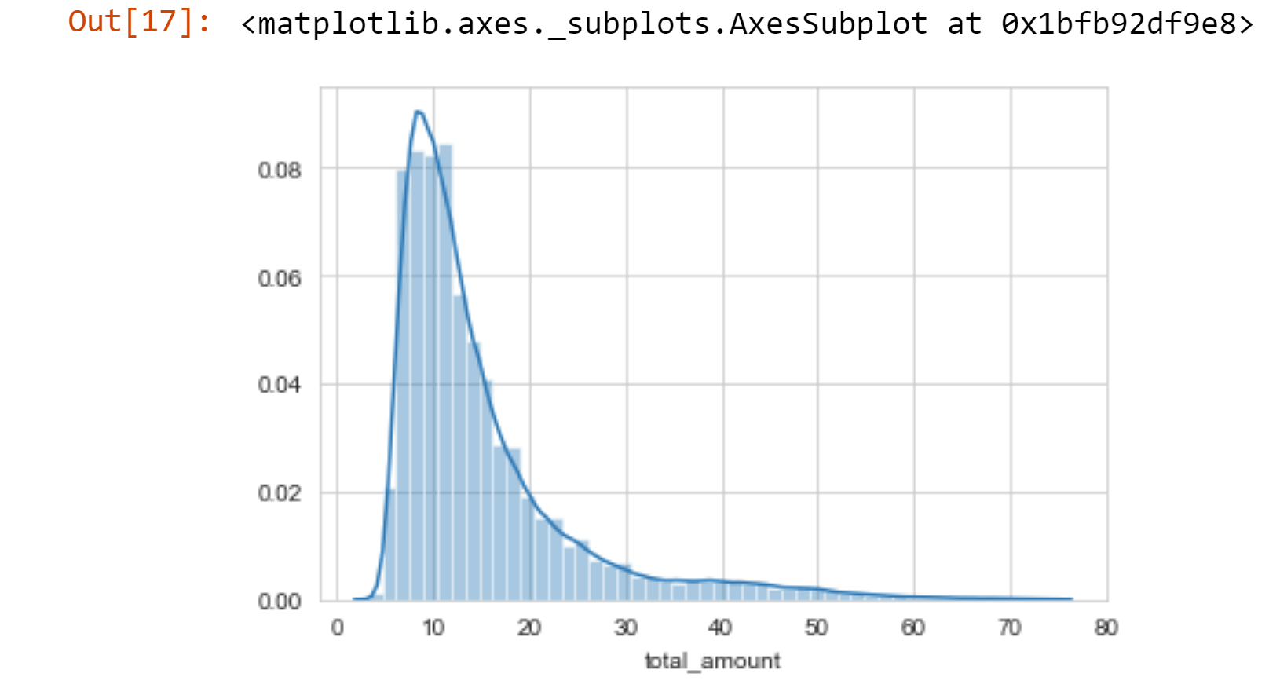
TotaL Amount Graphical Representation

Slide 7
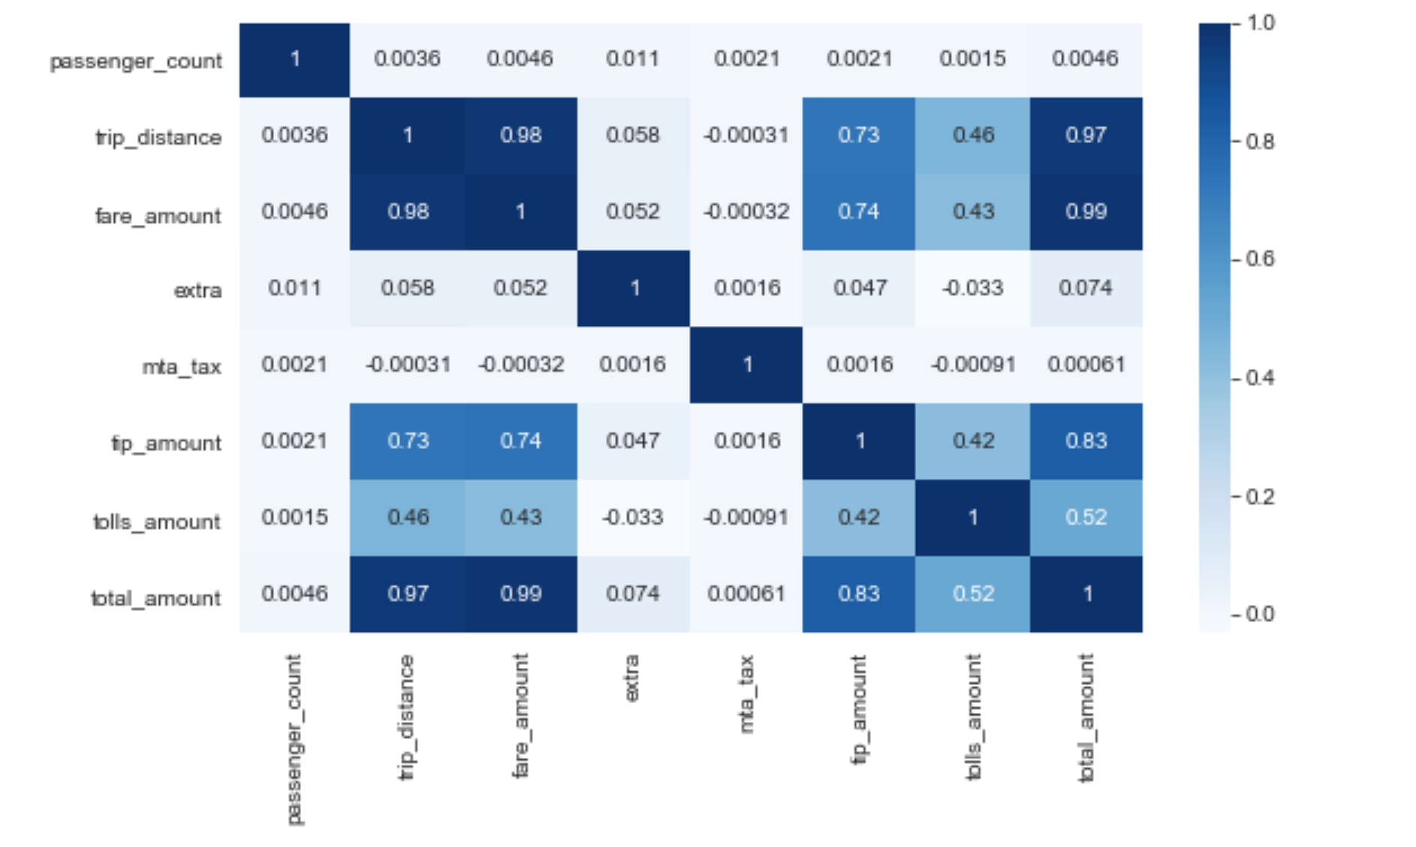
CORRELATION MATRIX

Slide 8
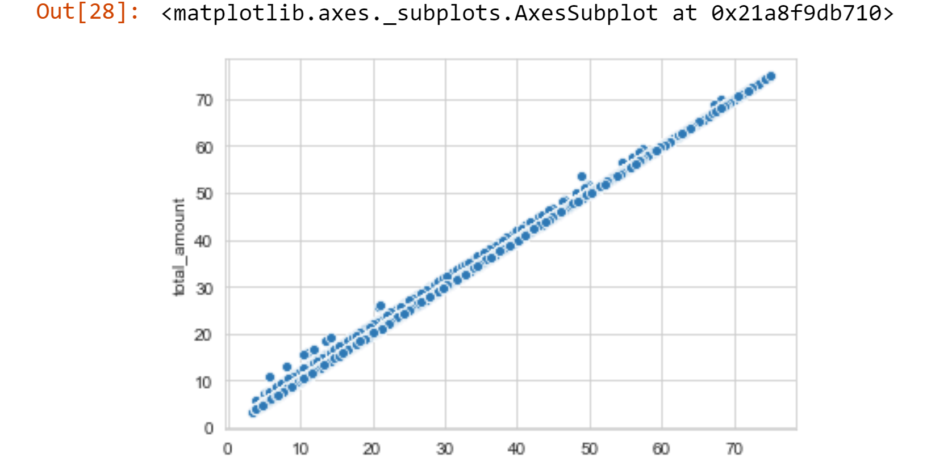
LINEAR REGRESSION GRAPHICAL REPRESENTATION

Slide 9
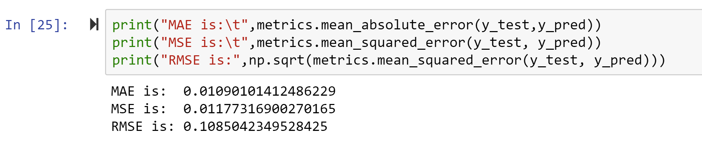
MULTI-LINEAR REGRESSION

Slide 10
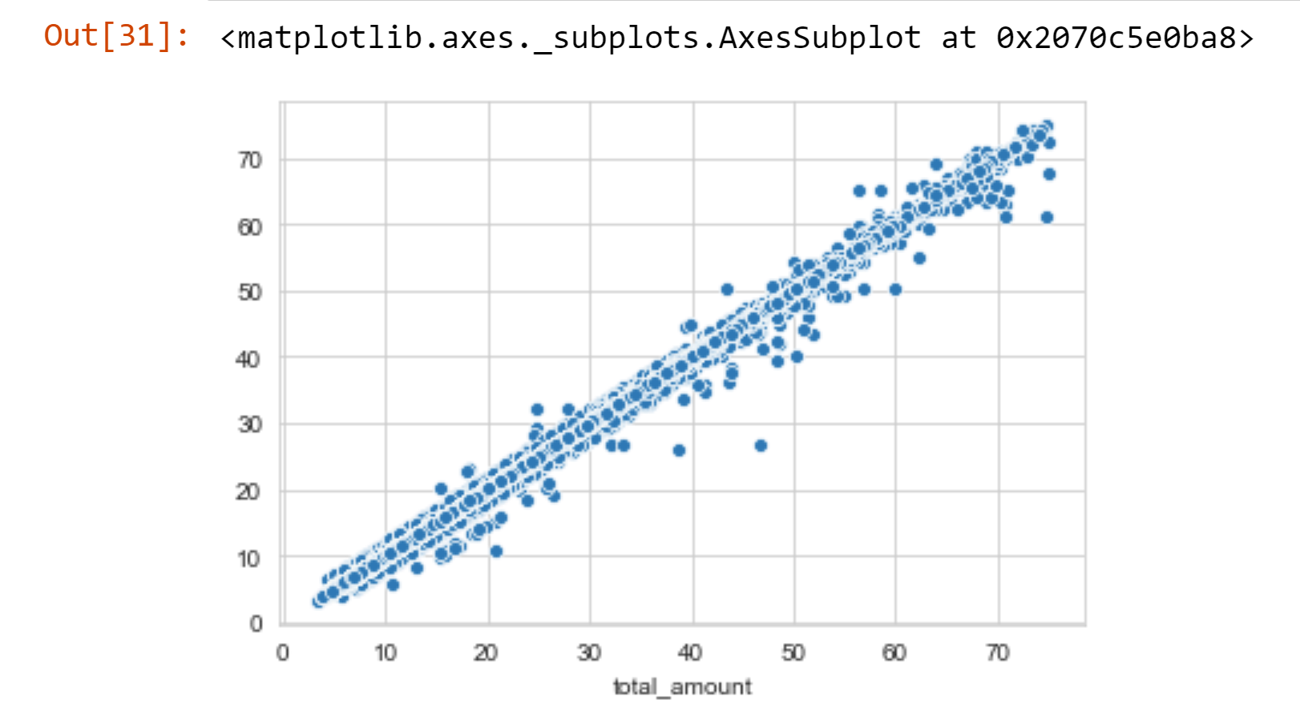
DECISION TREE GRAPHICAL REPRESENTATION

Slide 11
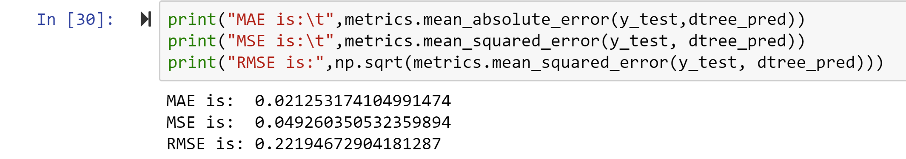
DECISION TREE PREDICTION ERROR

Slide 12
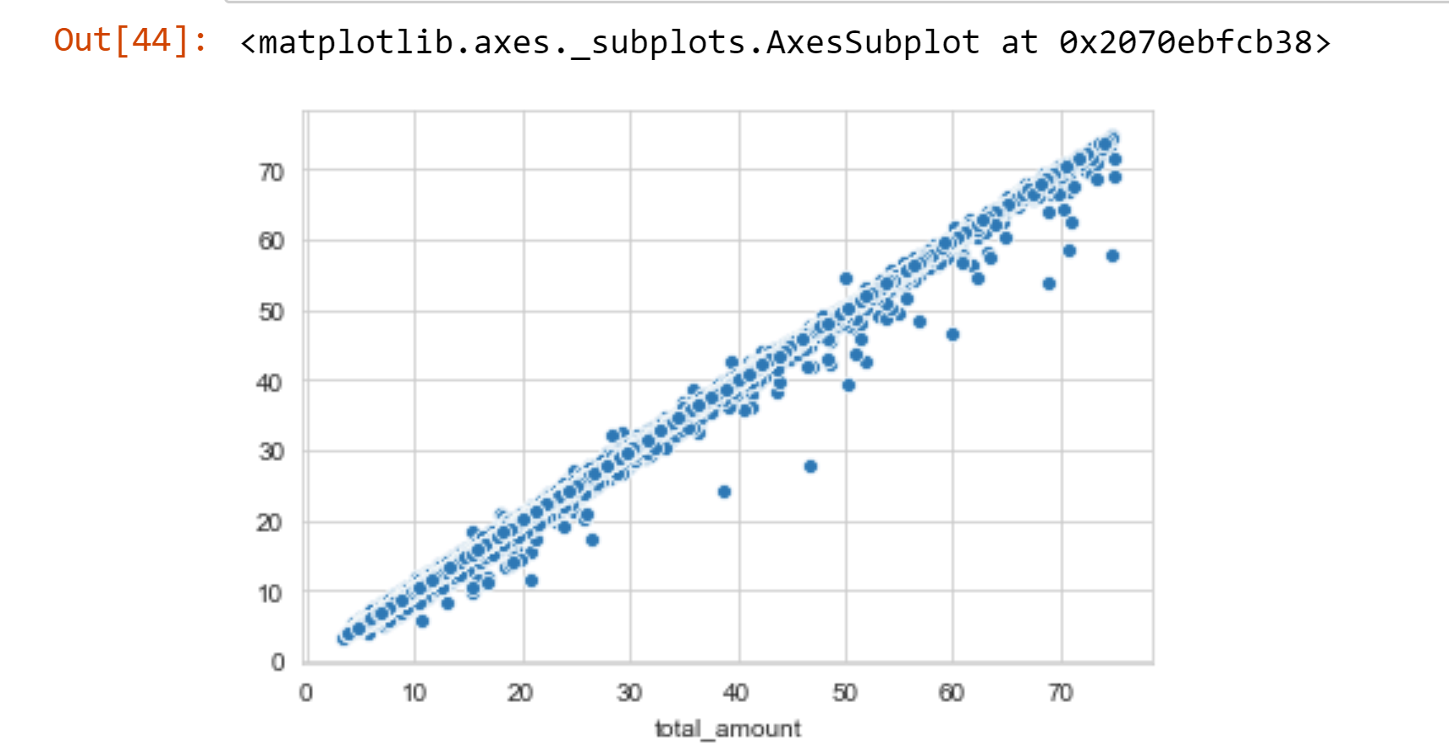
RANDOM TREE GRAPHICAL REPRESENTATION

Slide 13
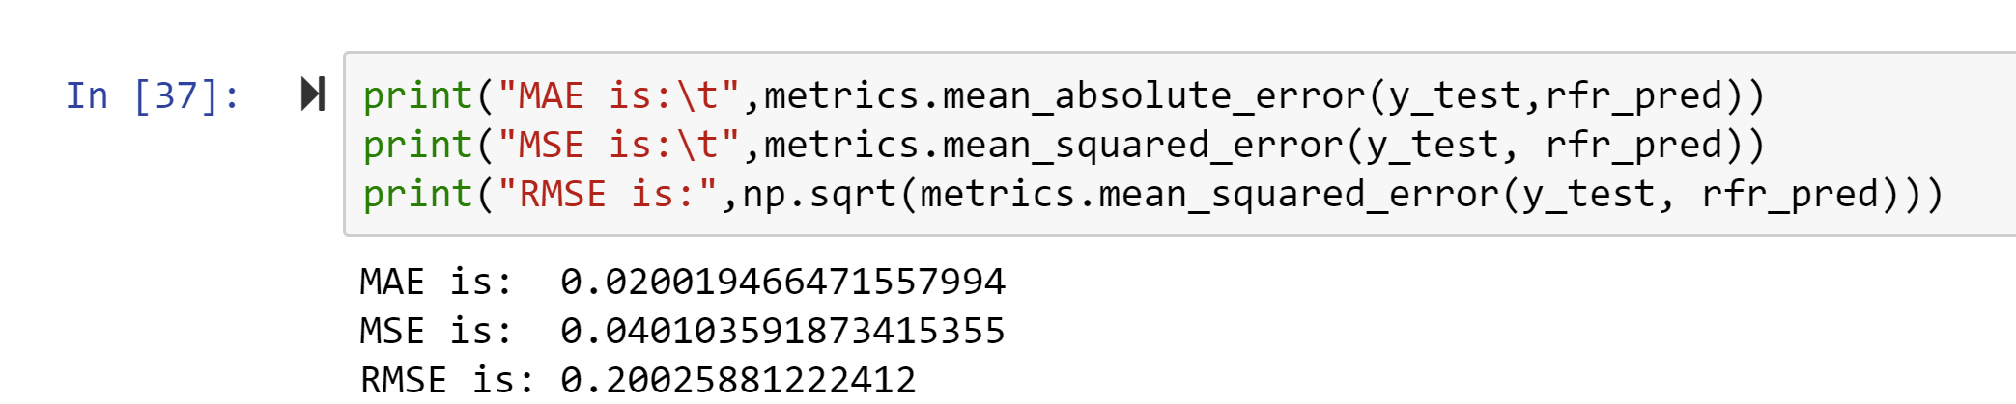
RANDOM FOREST PREDICTION ERROR

Slide 14
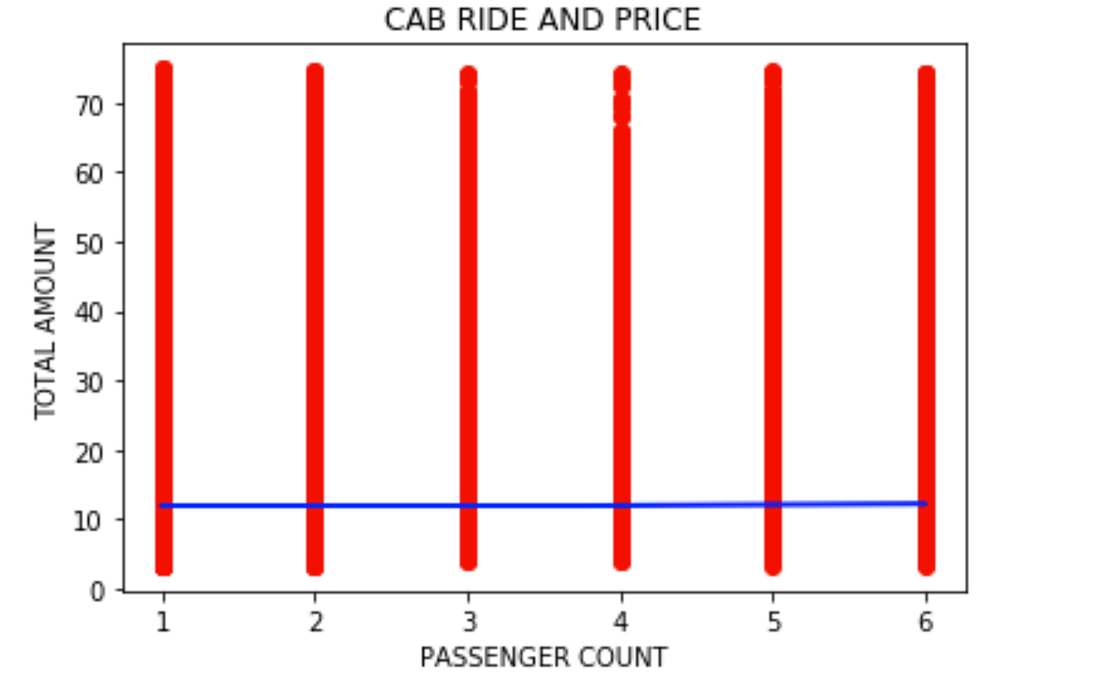
SVM GRAPHICAL REPRESENTATION

Slide 15
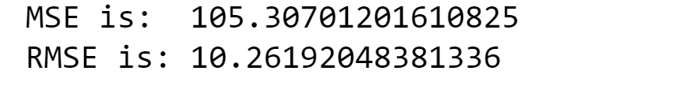
SVM ERROR PREDICTION

Slide 16
CONCLUSION
After performing the algorithms and looking at the metrics we can say that everything performed quiet well. But by considering the metrics for regression we can say that Multiple Linear Regression performed seemingly well.

